Slide 1
Team A Ken Berger, Jim Kurtz, Mark Lavine, Michael Schneider
Q4 CAR Champion Calibration
2015

Slide 2
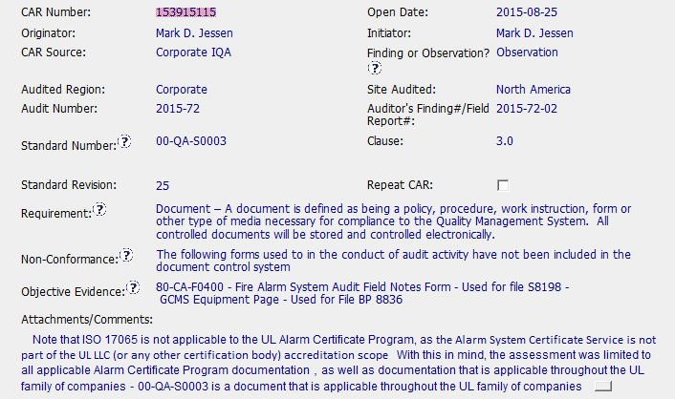
CAR# 153915115– Observation
Requirement, Non-conformance and Objective evidence are clearly stated and aligned.
Comments is a refining touch adding clarification in anticipation questions by readers of the CAR.

Slide 3
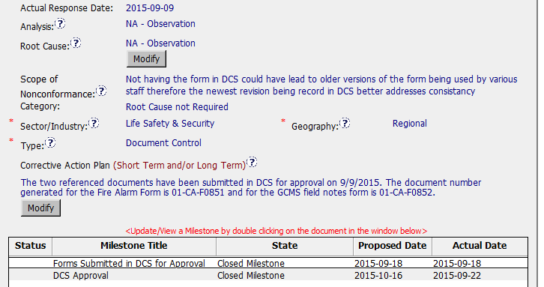
CAR# 153915115 – Observation
Category correctly selected for Observation CAR’s.
Tasks related to publishing “controlled” forms clearly stated and covered by milestones. CAP date for submittal to DCS is a mismatch with MS 1 however and could have been resolved with a single MS.

Slide 4

CAR# 153915115 – Observation
LINK to one of published forms is provided, one for each would have been better. Copies of what was submitted to teh DCS are in MS 1.
Evidence documents are published are PDF’s of system emails – ideal as there is no question.

Slide 5
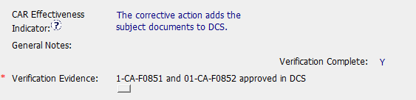

CAR# 153915115 – Observation
Verification is clear and to-the-point ☺
Verification completed in less than a minute of CAR Closing – excellent!

Slide 6
CAR 153915115 – CBS Check
CBS Requirements | Excellent | Moderate | Need Improve | N/A
INTEGRITY
(C) Extensions are within requirement (<30 days, 3 or less) |  |  |  | x
(T) Most appropriate ‘category’, ‘type’, ‘geography’ are selected | x
(P) Facilitates the handling of disputed CARs |  |  |  | x
(T) Acts on CARs within required timeframe | x
COMPETITIVENESS
(C) Analysis shows clear path to root cause and scope; stakeholders identified |  |  |  | x
(C) Root cause statement is succinct, reasonable, complete (Shows ‘N/A’ for observations) |  |  |  | x
(C) Corrective actions fix the objective evidence and other problems found; address entire root cause and scope. For observations, they do not go beyond fixing the objective evidence | x
(C) Milestones address containment & owner’s verification; completed per milestone expectations |  |  |  | x
(P) Verification per requirements | x
COLLABORATION
(L Referenced communications are attached as needed | x
(C L) Evidence of communication for overdue/escalated CARs and other pertinent concerns |  |  |  | x
(P) Trains other CAR Champions |  |  |  | x

